Slide 1
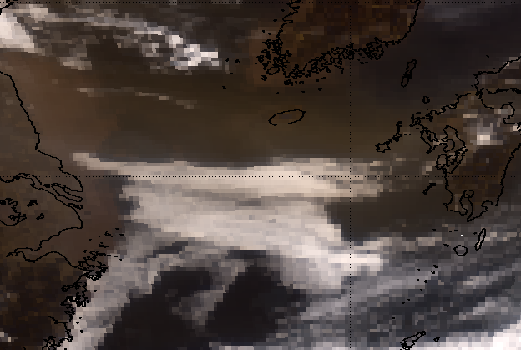
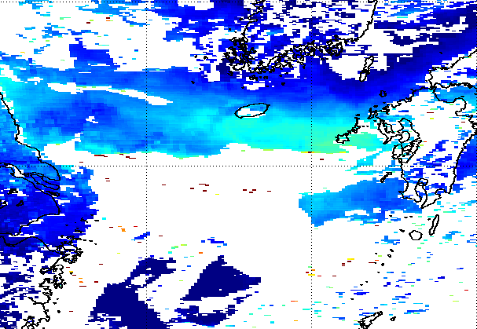
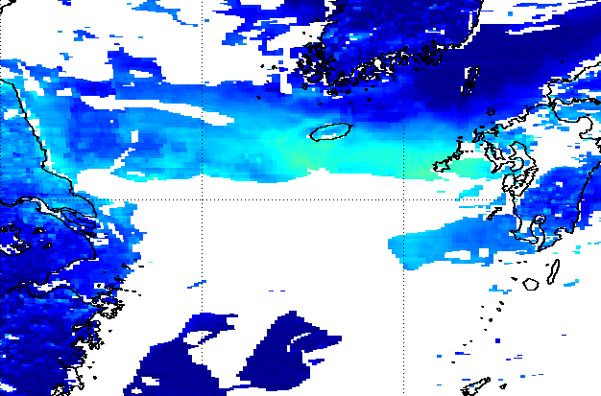
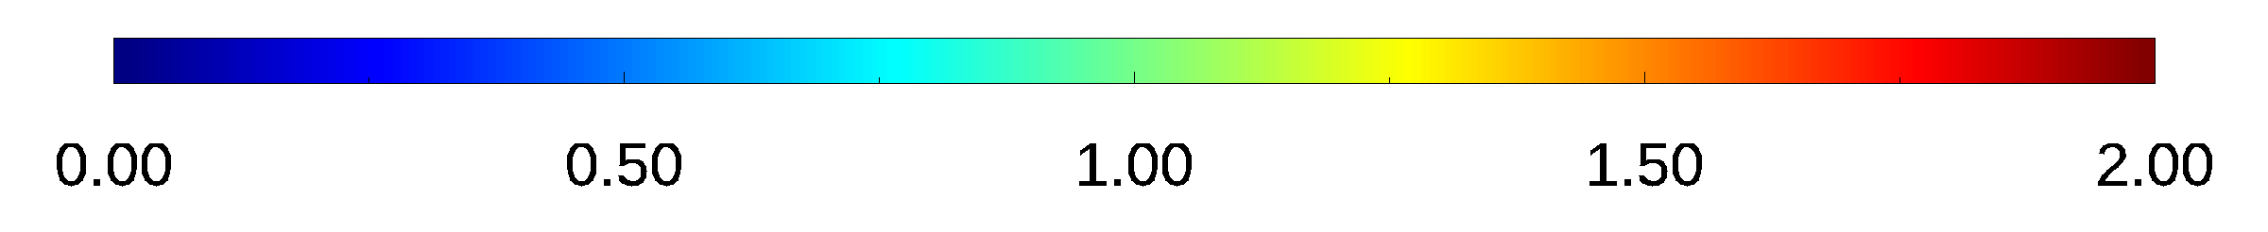
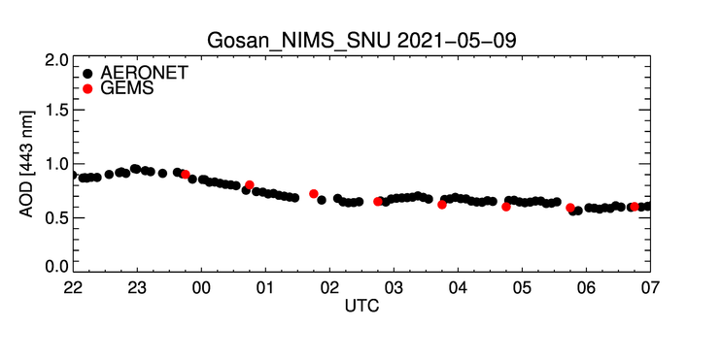
Lessons learned from GEMS w.r.t aerosol retrievals
V1
GEMS AOD 443 nm
V2
GEMS AOD 443 nm
GEMS False RGB
Cloud masking
Since GEMS spectral range lacks infrared (IR) channels, it can be challenging to differentiate between clouds and heavy aerosols.
We have been updating and testing appropriate cloud masking methods since the IOT period and up until now.
To tackle this challenge, GEMS may consider using complementary data from other sources that have IR channels in the future.

Slide 2
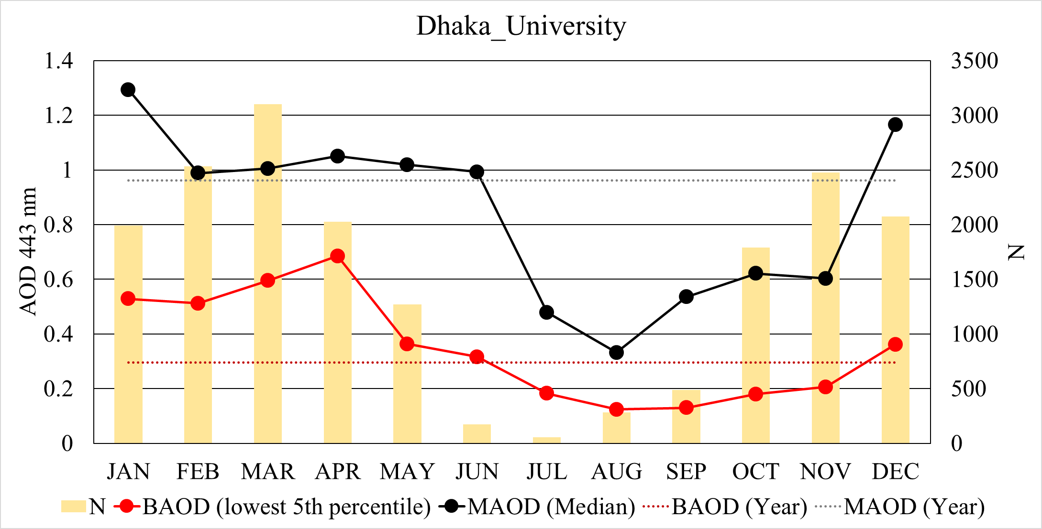
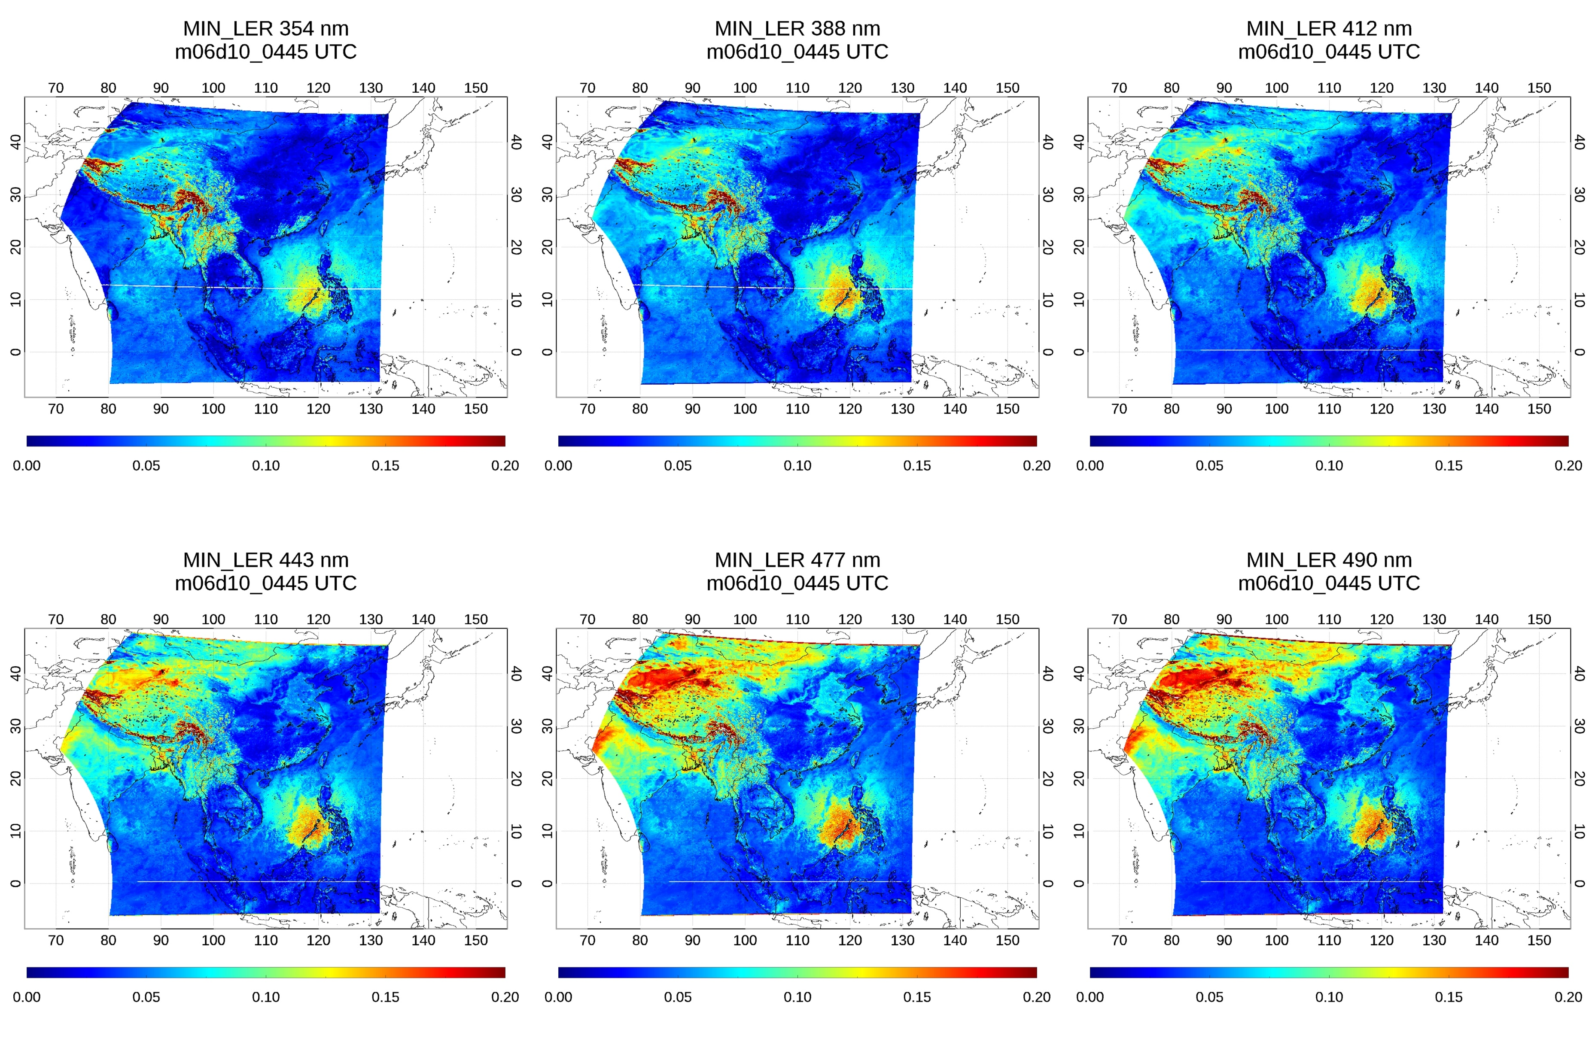
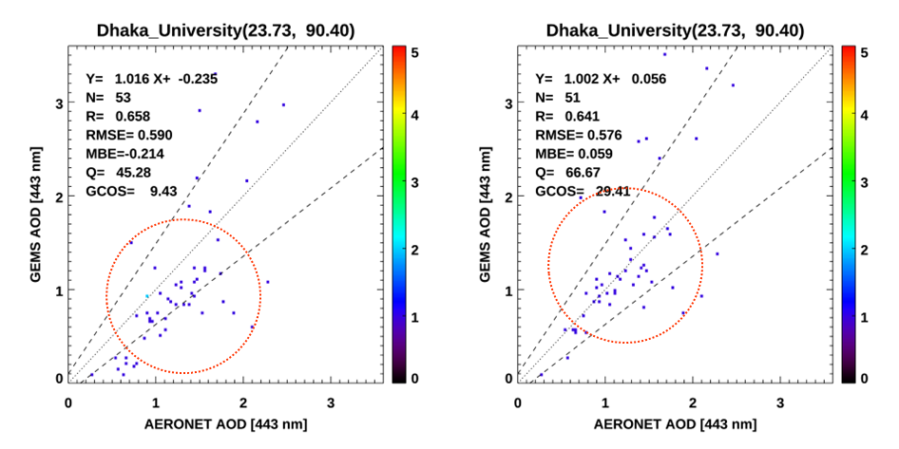
Lessons learned from GEMS w.r.t aerosol retrievals
GEMS Surface Reflectance
354 nm
388 nm
412 nm
443 nm
477 nm
490 nm
BAOD X
BAOD O
Surface reflectance
Now, the GEMS aerosol algorithm uses the climatological minimum reflectance method for each pixel over a ± 15-day window for a period of 2 years.
We have conducted various tests on the time window (± 15-day window, -30-day window) and method (minimum, second minimum) to determine the best approach for constructing proper surface reflectance.
We also plan to consider monthly Background AOD (BAOD) to further improve the accuracy of surface reflectance.

Slide 3
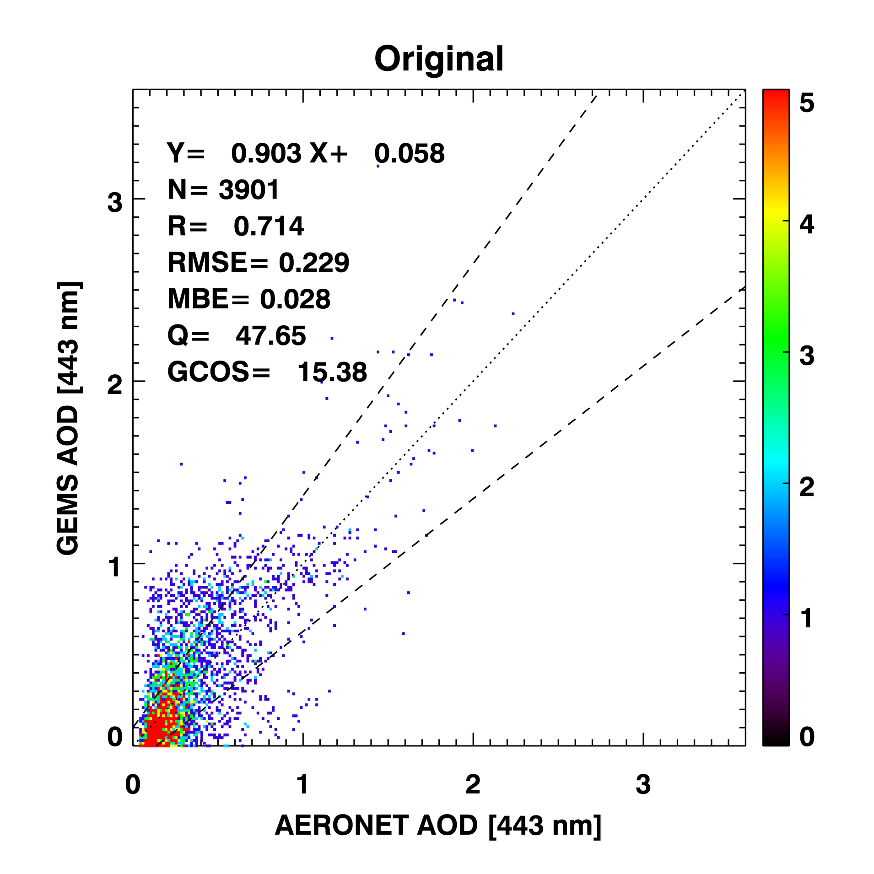
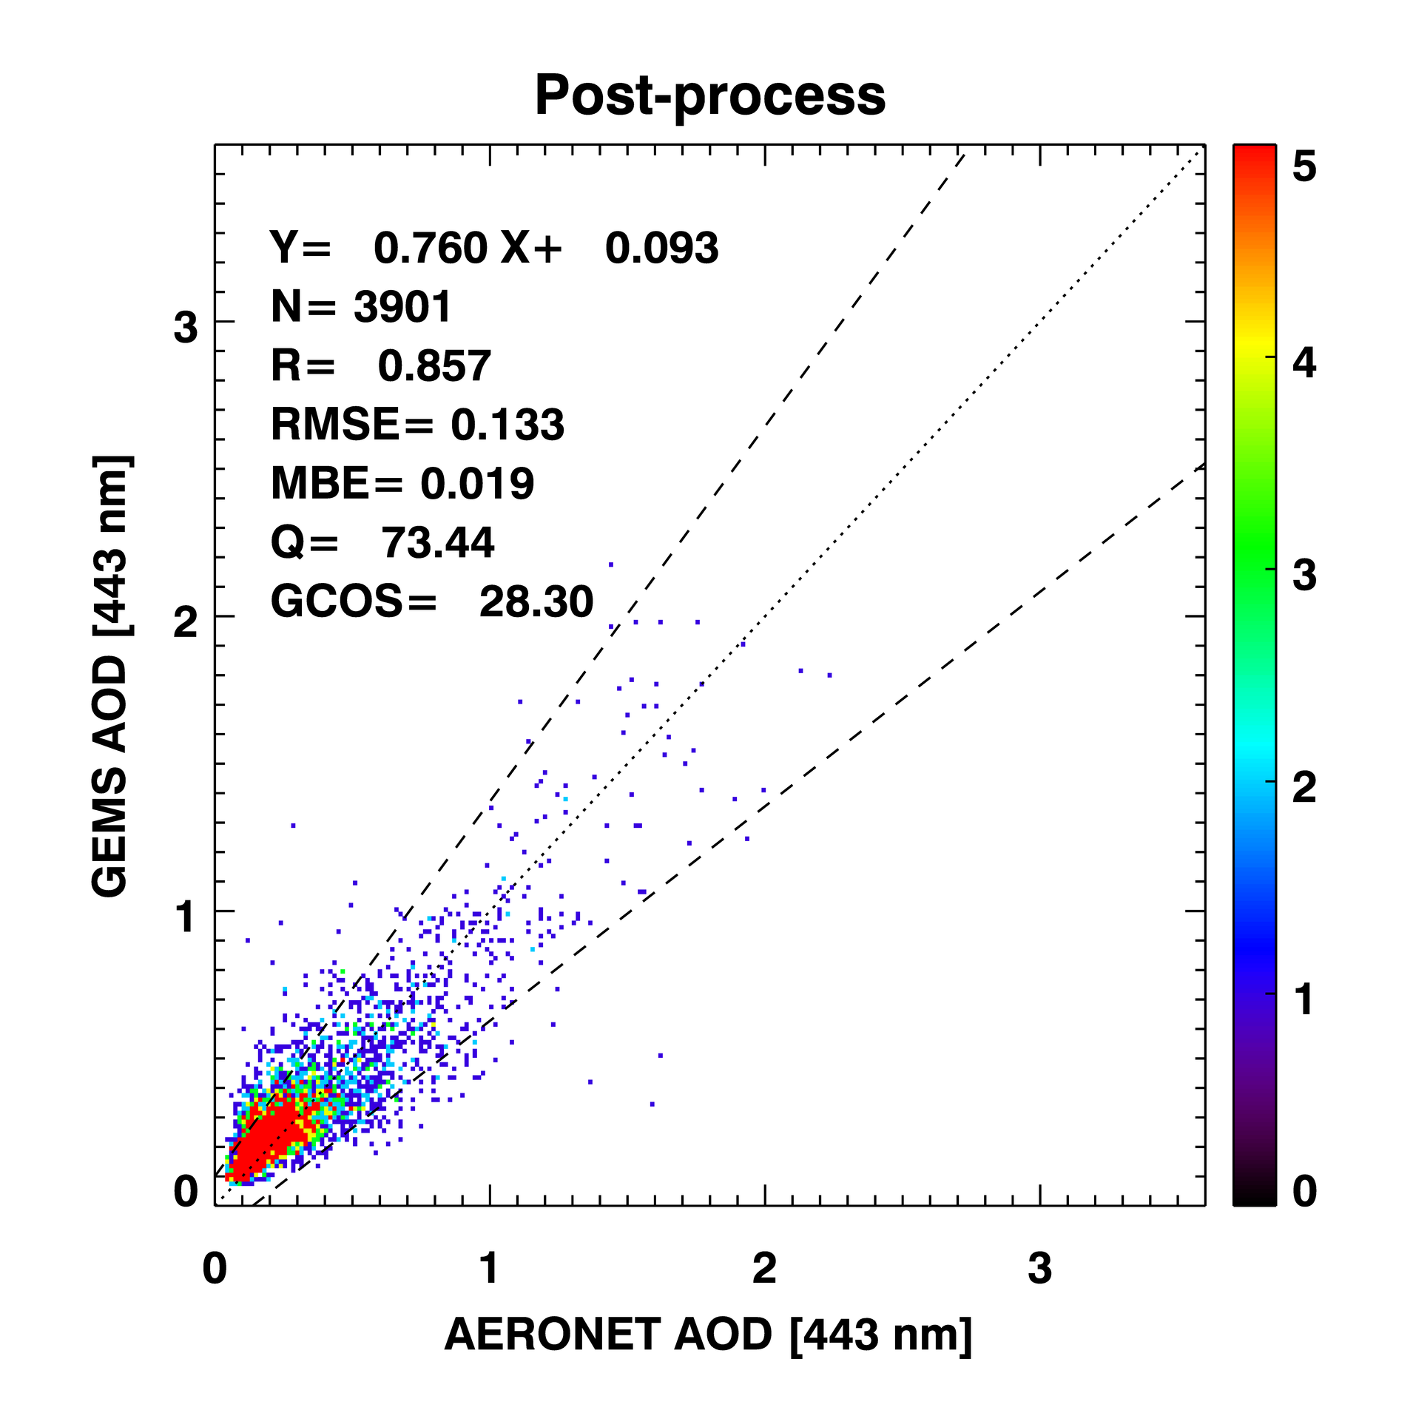
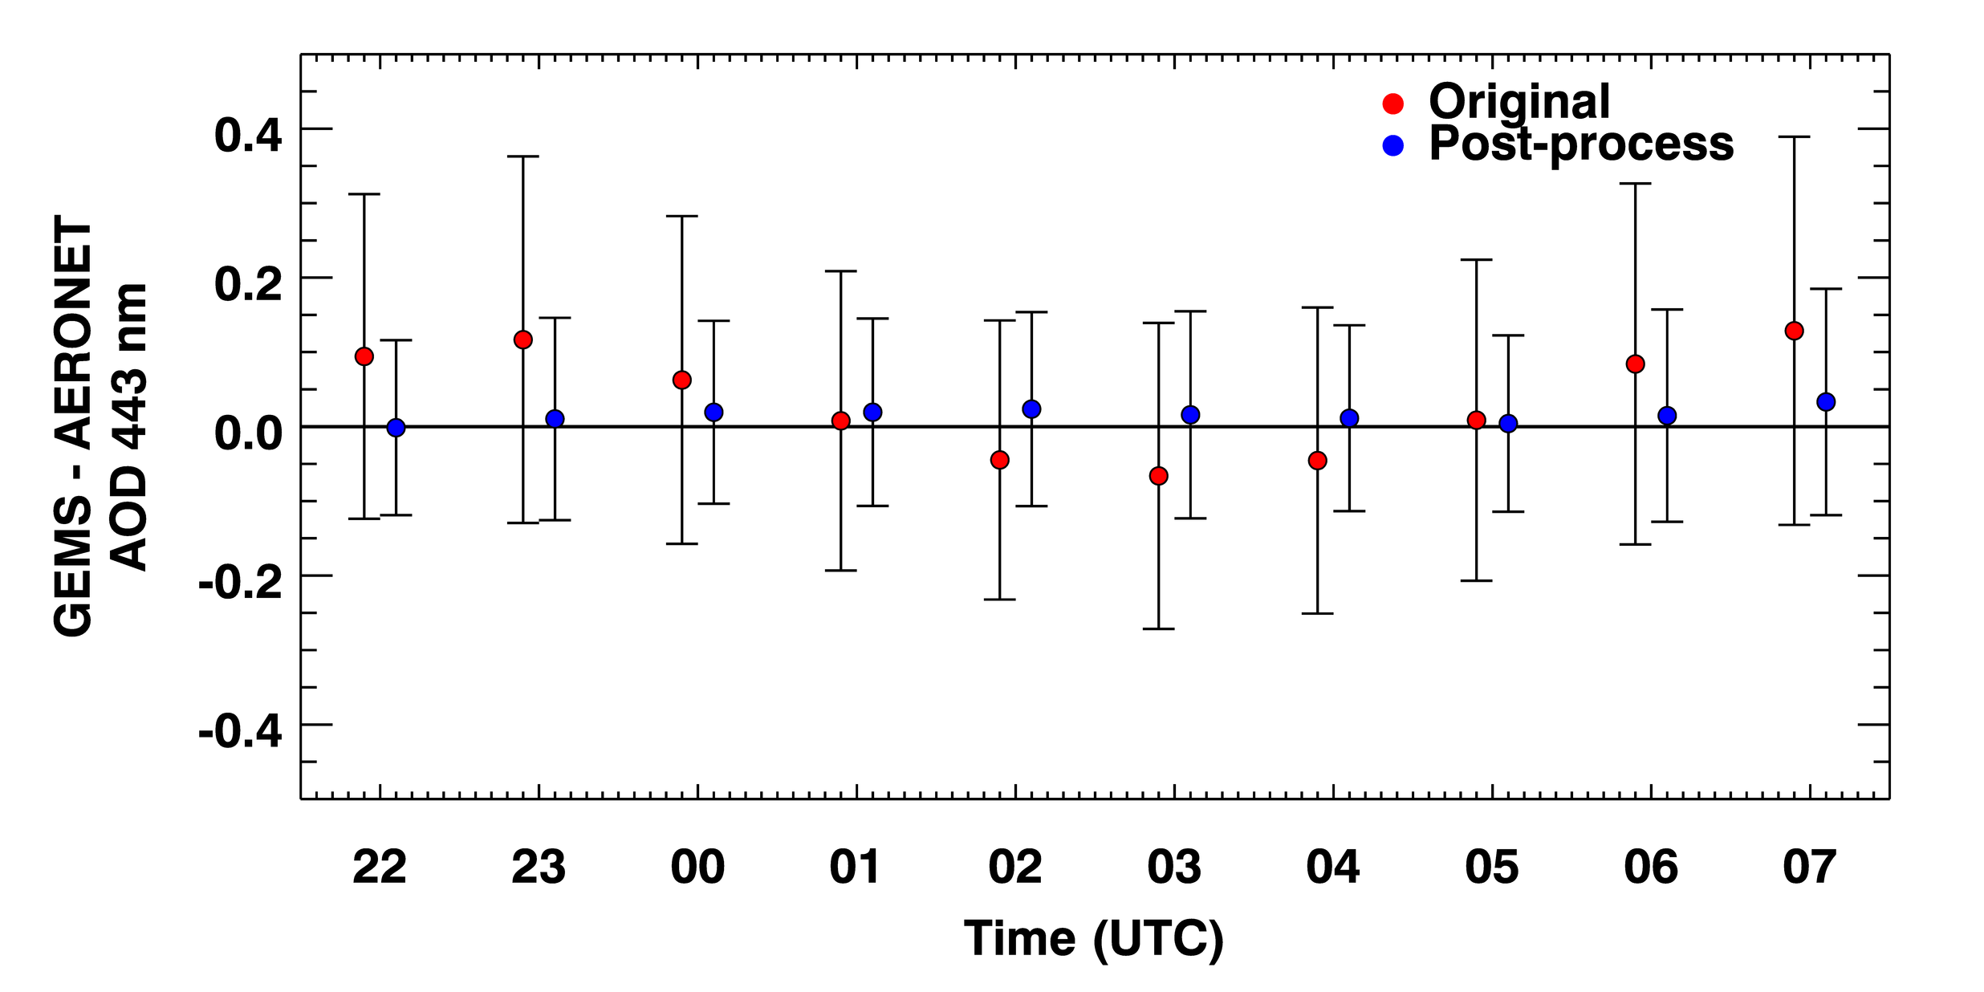
Lessons learned from GEMS w.r.t aerosol retrievals
Validation area: East Asia
Validation period: 2021.04.01-2021.06.30
Diurnal pattern of biases is found.
The original GEMS AOD showed a bias that varied throughout the day, with a minimum at 03:00 UTC (forming a U-shape).
Combining the GEMS aerosol retrievals and post-processing from random forest-based correction model for the approximation error in the retrieval.
i.e., RF modeling using data from March 20th, 2023 to April 20th, 2023 at 03:00 UTC to predict AOD error at 04:00 UTC on April 20th, 2023.
After applying the model-enforced post-processing correction, the AOD bias was reduced to a value close to zero at all times of day.

Slide 4
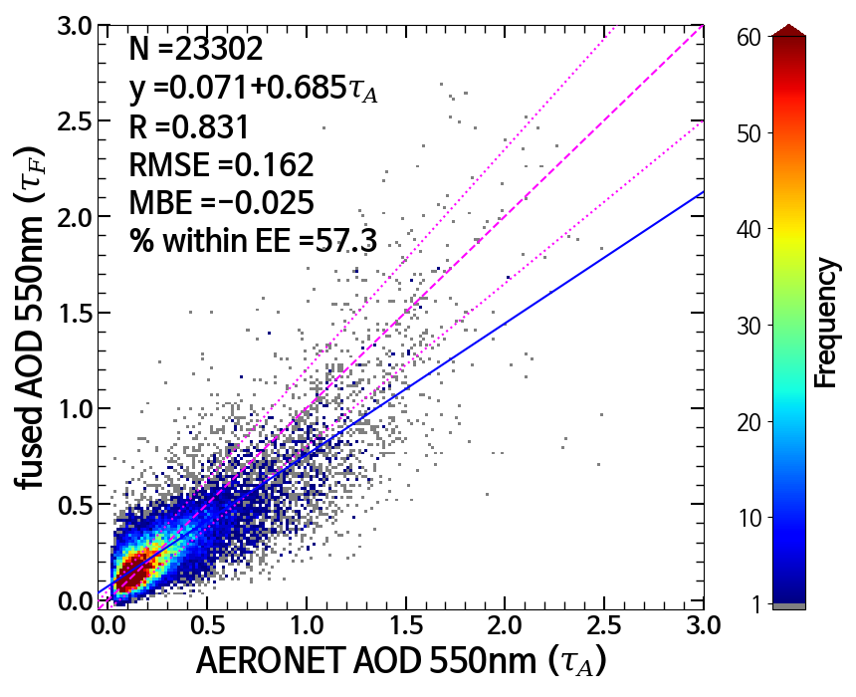
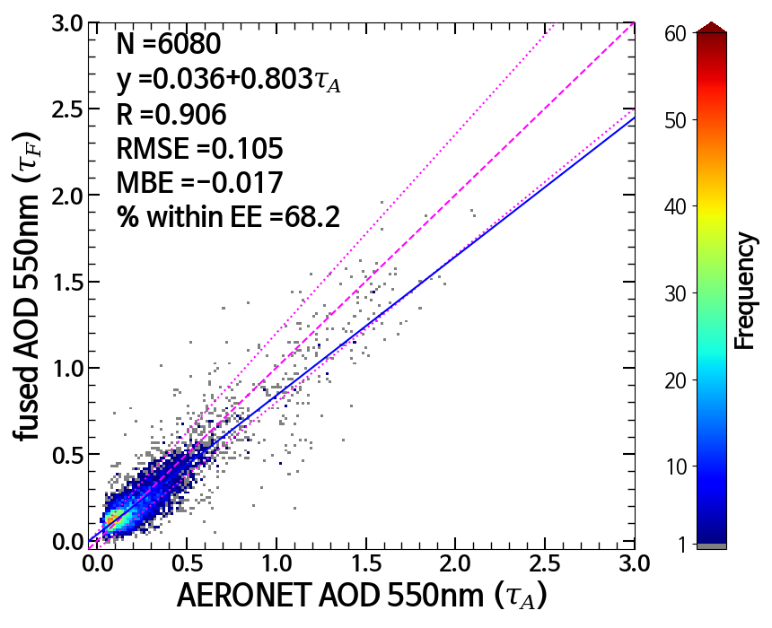
GK-2A/-2B AOD fusion: Validation
Jan. 2022 ~ Aug. 2022
vs. AERONET V3 L1.5
R > 0.9 after fusion when all three L2 AOD are used.
High quality AOD over a broad region through fusion.
QF≤3 fused AOD are mainly AMI + GEMS, which shows better result than individual AMI and GEMS AOD.
Better AOD is expected when all 3 AOD products are fused.
QF$\text{≤}$3 (more than 2 AOD products fused)
QF=0 (all 3 AOD products fused)
 | AMI | GOCI-II | GEMS V2 | Fused (QF≤3) | Fused (QF=0)
N | 31710 | 9080 | 23053 | 23302 | 6080
R | 0.731 | 0.844 | 0.694 | 0.831 | 0.906
RMSE | 0.225 | 0.153 | 0.247 | 0.162 | 0.105
MBE | 0.007 | 0.027 | -0.108 | -0.025 | -0.017
% within EE | 45.3 | 63.3 | 41.7 | 57.3 | 68.2
Slope | 0.745 | 0.914 | 0.483 | 0.685 | 0.803
Offset | 0.080 | -0.002 | 0.070 | 0.071 | 0.036
Notes:
QF<=3 인 자료는 산출 영역 문제 때문에 주로 GEMS 와 AMI가 융합된 자료인데, 이 부분만 봐도 GEMS, AMI 단일 산출물보다 정확도가 높아짐.

